Slide 1
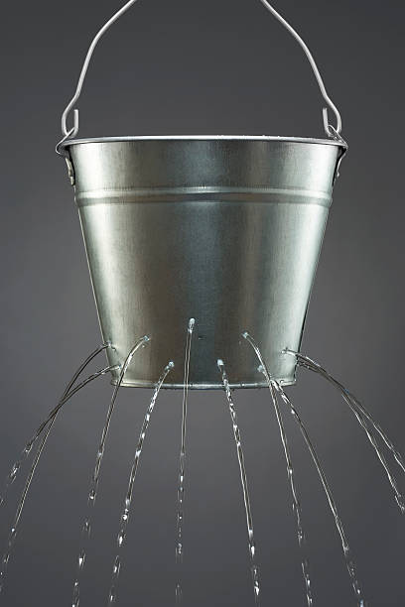
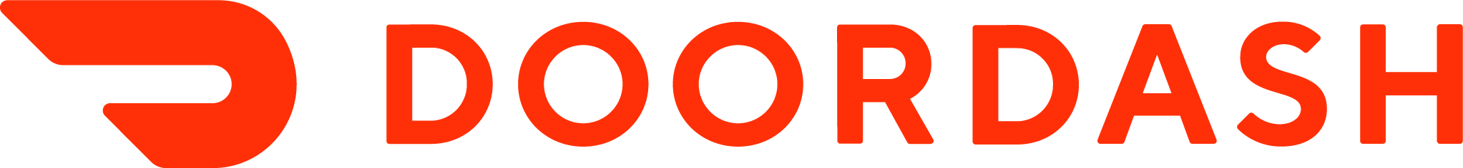
Churned Leaky Bucket
DRI: Kelly Peterson
Date: Nov 10, 2023

Slide 2



Research approach
We conducted 6 interviews with churned Cx who had clicked on a affordability resurrection email in the past week
The sample was split 50/50
  3 Cx clicked on the email, visited the app and did not convert
  3 Cx clicked on the email but did not visit the app or convert
The goal of these calls were to understand…
Message awareness: Do Cx recall opening emails from DoorDash that are focused on affordability and savings? What messages are resonating with customers? Where are we missing the mark?
Strengths and weaknesses of messaging: Do the emails we send to Cx resonate with them? Do they align with Cx experiences and expectations? What can we do to make them better?
Motivations and drivers: What ultimately is keeping them from visiting the app and/or converting. What is needed for them to feel motivated to convert. What role do the messages we send play in this? What messages may be most impactful?
The research brief can be found here.
Notes:
James to link to failed session

Slide 3
Why do Cx not visit the app?

Slide 4



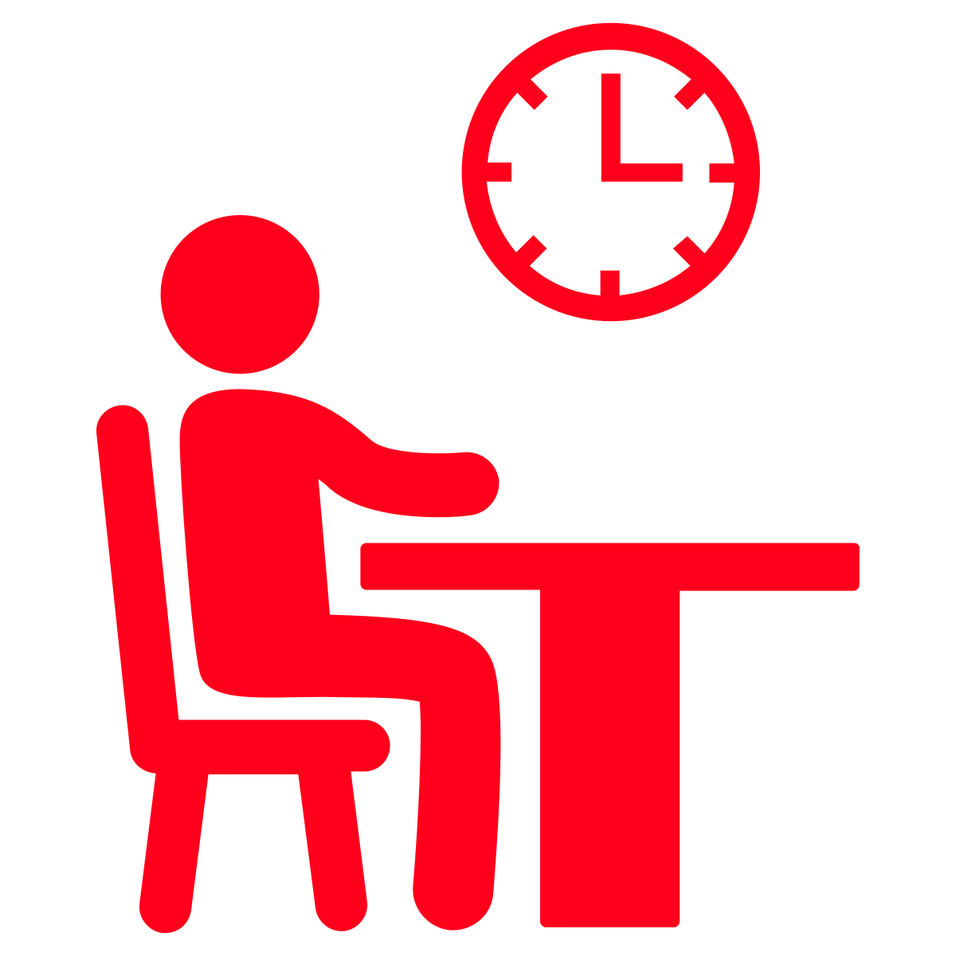

Cx interviewed tend to rely on promotions to “plan to order”
Receives email
Compares to other promo emails
Plans to use in upcoming week
Places order with promo
Waits for next promo prompt

Slide 5
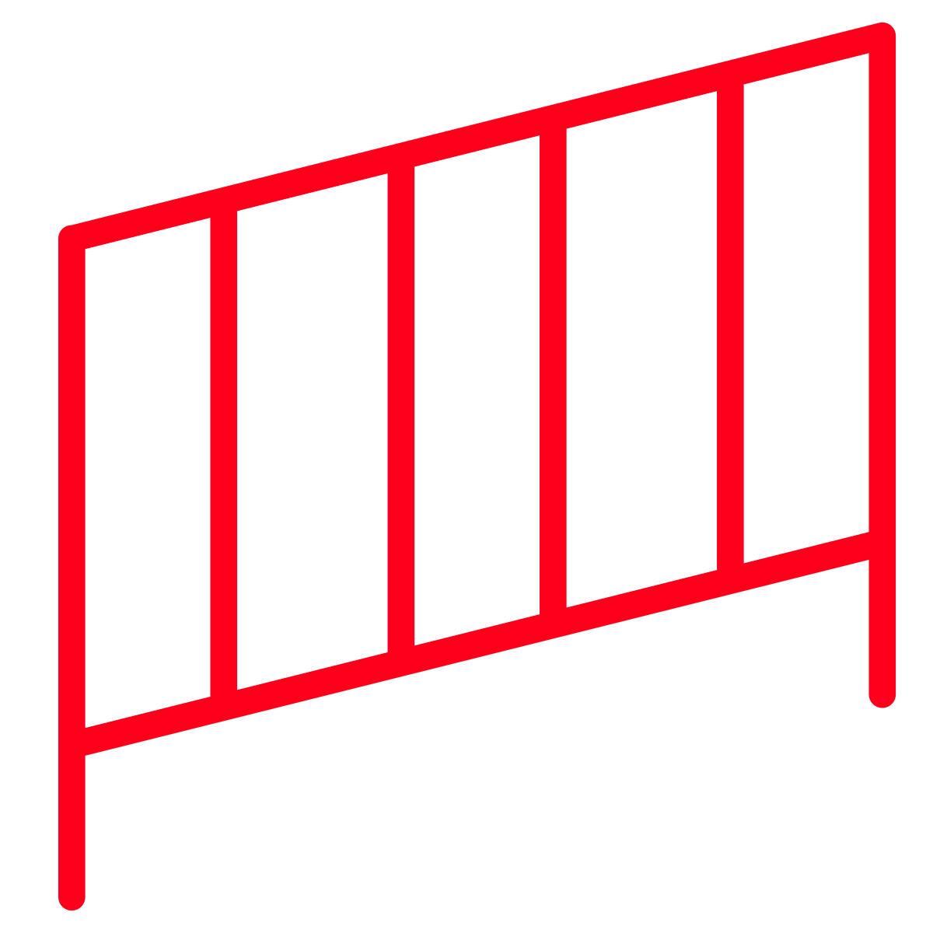
Cx already have certain guardrails in place when it comes to savings
Cx tend to ignore savings offers that are “up to $5” or less and less than 20%
Having free delivery is a big motivator
If Cx have a subscription (primarily through a partnership) $0 delivery + additional promotions is a must to motivate them
Savings have to overcome the added cost of service fees & tipping

Slide 6
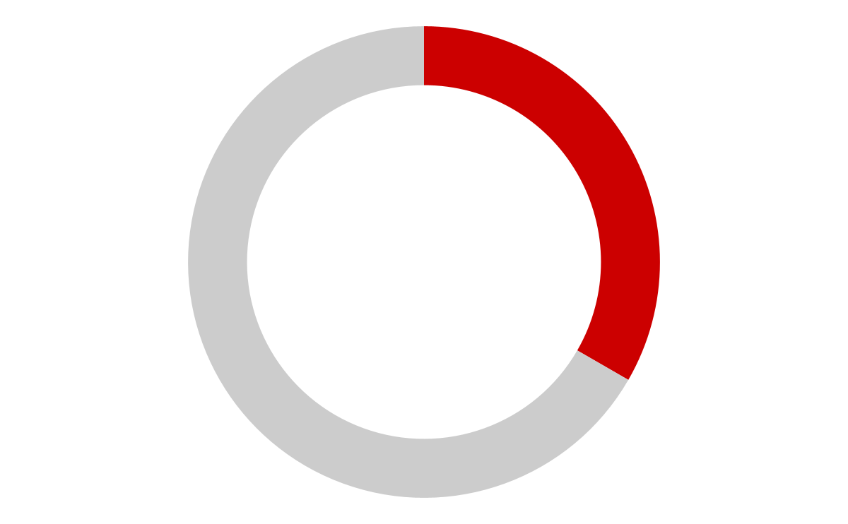
Recall and visit awareness
Only 2 out of 6 Cx recalled receiving an email
Cx who did not recall receiving the email either:
Do not pay attention to emails
Could not differentiate between many DoorDash, UberEats, GrubHub and Instacart emails
Only recalled receiving emails about DashPass

Slide 7


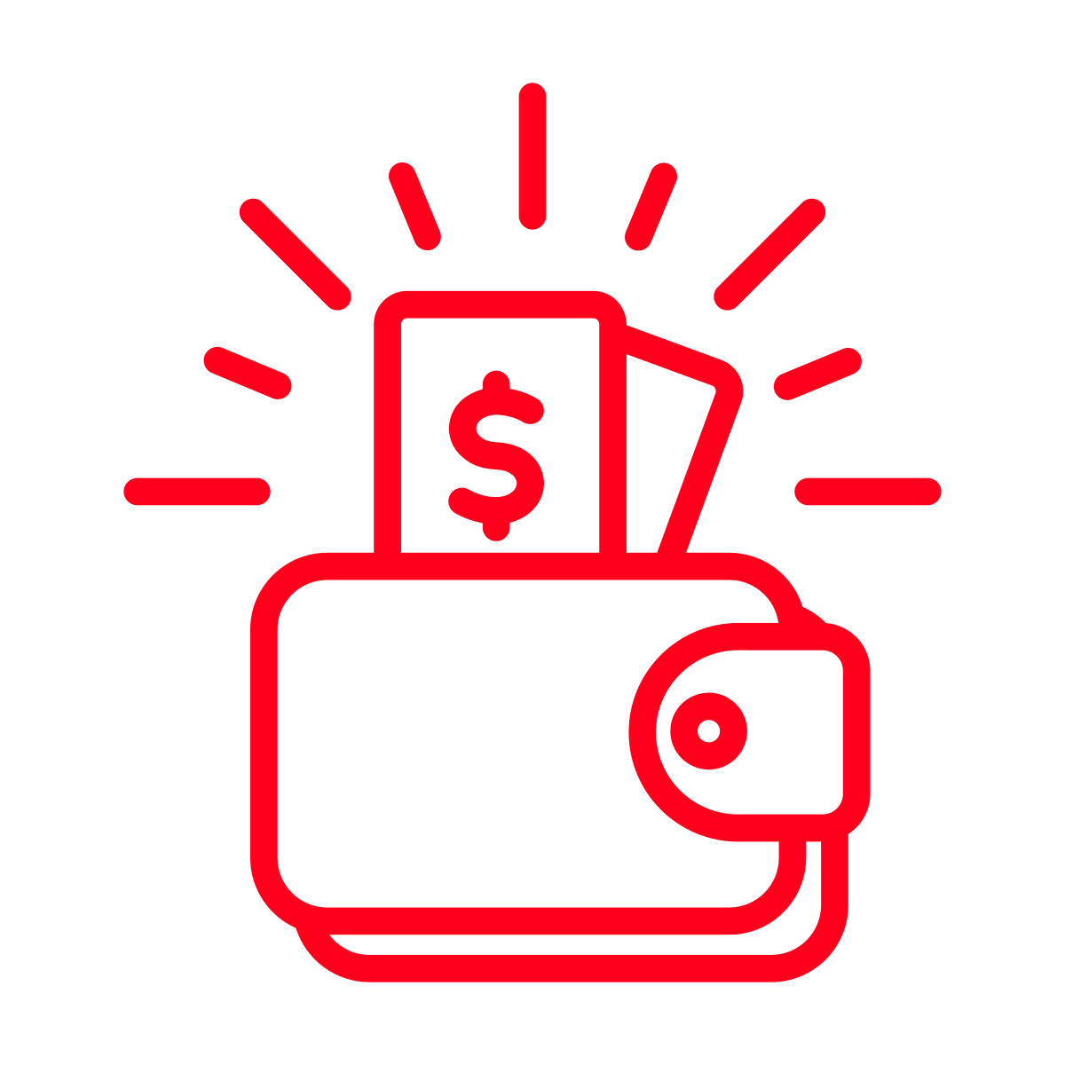

Why aren’t Cx opening/remembering emails?
I get too many emails/I didn’t realize
Prefer to learn via in-app notifications
Gap between reading and ordering
My life changes in the winter
Cx mention that winter travel and end of year/holiday budget concerns cause them not to want to order
Cx mention a preference for cooking at home “comfort foods” in the winter
I am getting similar UE emails at the same time with higher savings offers (e.g. 40%)
Some Cx just feel like UE has better savings overall or have Uber One through partnerships
I can’t use it on pick up
Many Cx use pickup as a way to manage costs by avoiding delivery & service fees

Slide 8

Brands become blurry for some Cx

Slide 9
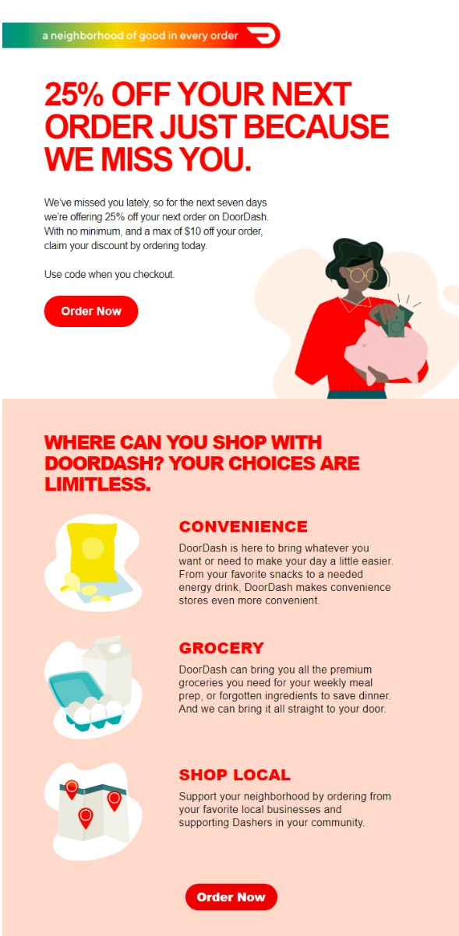
What do Cx think of our affordability resurrection emails?
Some Cx said they like the “we miss you” message. It feels more personal, less transactional and gives a reason why this offer is being provided.
The “good stuff” is in the fine print. Cx feel like they missed this
$10 is a good maximum saving amount from their perspective and Cx feel they would be more impacted by that number
Cx didn't realize the 7 day use; more urgency might have brought it top of mind sooner
Some Cx were weary about the need for a promotion code because of bad experiences in the past where it did not work.
Cx noted this information is helpful in terms of learning about grocery but it is not necessarily motivating for them.

Slide 10
We also tested some message themes with Cx
Message | Service | Benefit
With DoorDash, you can order with peace of mind that your food will arrive fresh and on time: 98% of orders are delivered on time without any missing items. | Quality | Peace of mind
With DoorDash, you can find great deals any time you open the app, like $0 delivery fees and 10% off, from restaurants in your area. | Deals | Save money
With DoorDash, you can get personalized recommendations based on your preferences, making it easy to find new options that you’re excited to try. | Personalization | Ease Discovery
With DoorDash, you can browse according to your dietary preferences, helping you more easily find food that meets your needs. | Personalization Dietary Preferences | Ease
With DoorDash, you can see the total price of your order up-front (inclusive of fees, tax, and suggested tip) instead of only at checkout, helping you find options within your budget more easily. | Browse by total price | Save money
With DoorDash, you can get customer support that goes above and beyond in making things right if something goes wrong or doesn’t meet your expectations. | Customer service | Peace of mind

Slide 11
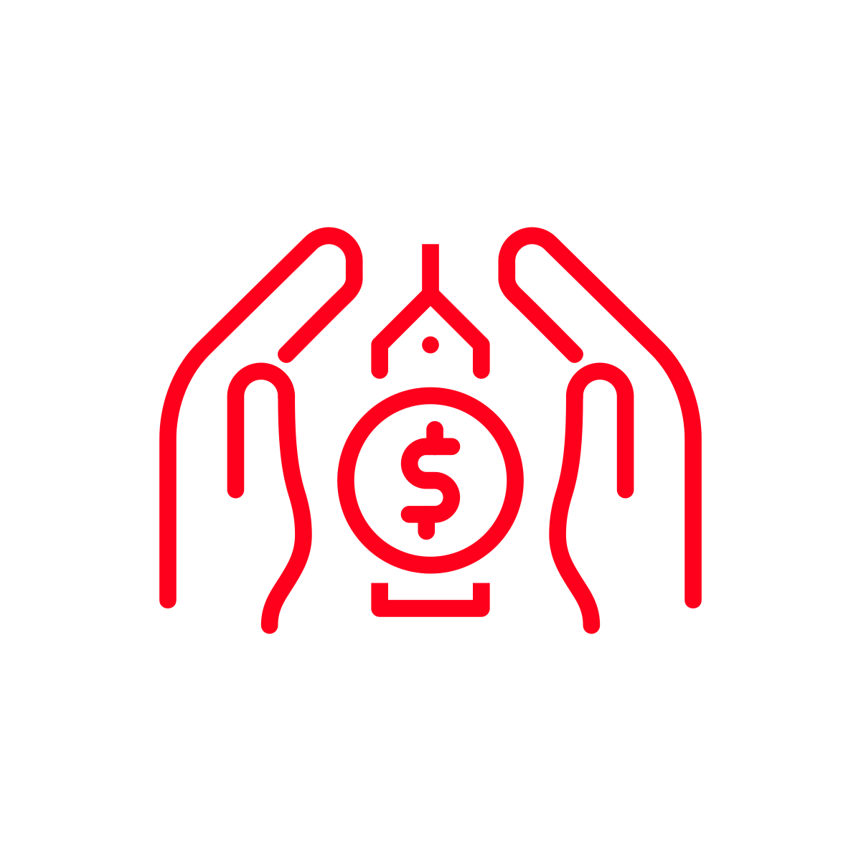
Not surprisingly, Cx gravitated towards affordability messages and found those to be the most motivating
“Like $0 delivery and 10% off. I feel like that's a motivation. Where it's like, oh, then I compare it to like cooking or something like that for the evening. And I'm like, oh, actually that sounds nice. Like no delivery fee. Then I don't have to go, I don't have to leave my house.”
“I like the idea of that (price) being transparent throughout the process. Instead of this is what I want to do, and then going to checkout and being like, oh, crap. I didn't really think about the fact that I'm adding $12 now.”

Slide 12
Some Cx felt quality themes should be looped into savings messaging; while others found them to be pointless
“I'm like your your food arriving like fresh and on time. I feel like that's important. 90% of orders are delivered on time. I feel like that's like, helpful. Usually when I'm ordering, I'm super hungry. So that's motivating.”
Vs.
“I don't agree with what it's saying. I need percent of orders are delivered on time without missing items. That has not been my experience.”

Slide 13
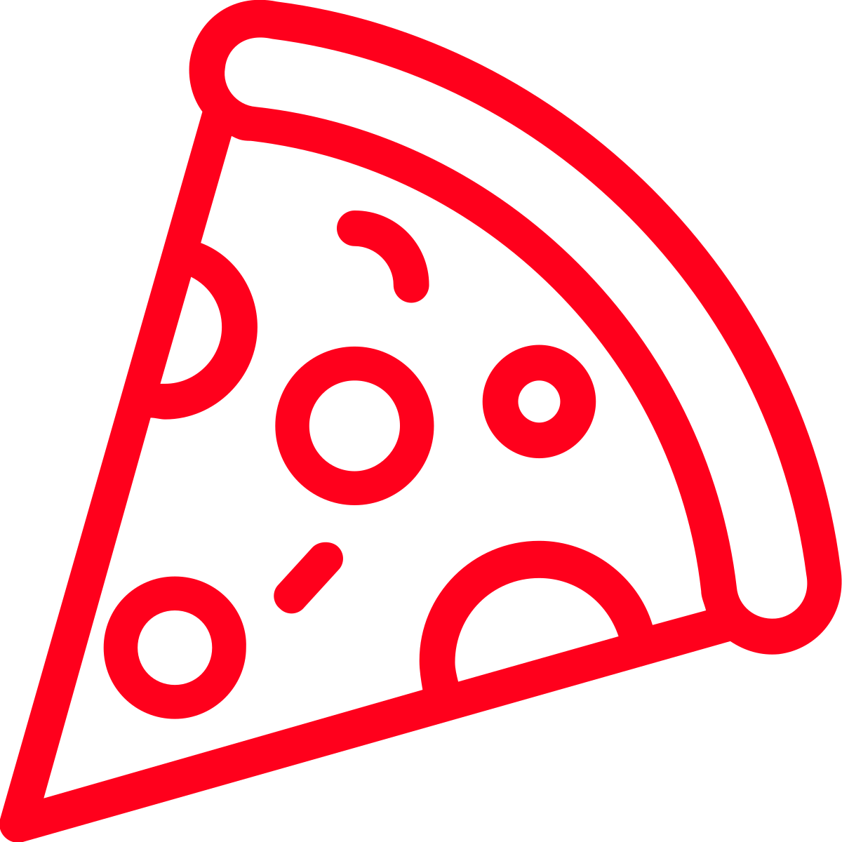
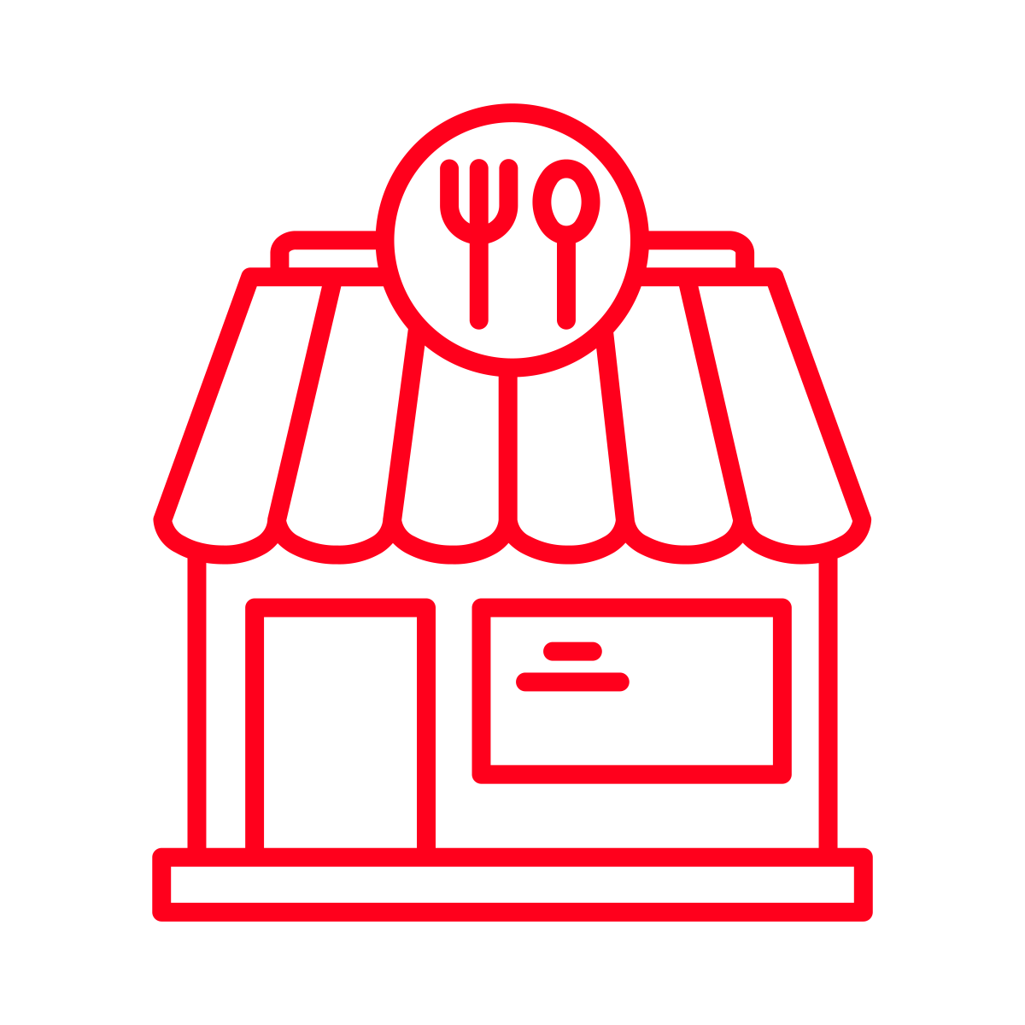
When it comes to personalization Cx wanted to “see” rather than “be told”
However, Cx had a wide range of what they wanted to see:
I just moved, new places to try would help
My life is so busy, I just need food fast
I know the places I like, just focus on that
I know what cuisines I like, show me pictures
“If you guys had included, like, a photo of, (even if it wasn't a restaurant necessarily that I'd gone to) a photo of, like, an actual slice of pizza, I would be like, dang, I do want a slice of pizza or something like that”
“maybe if you guys attach, like, one of the restaurants or, like, a couple of the options that I've used in the past, then I'd be like, oh, they were really good”

Slide 14
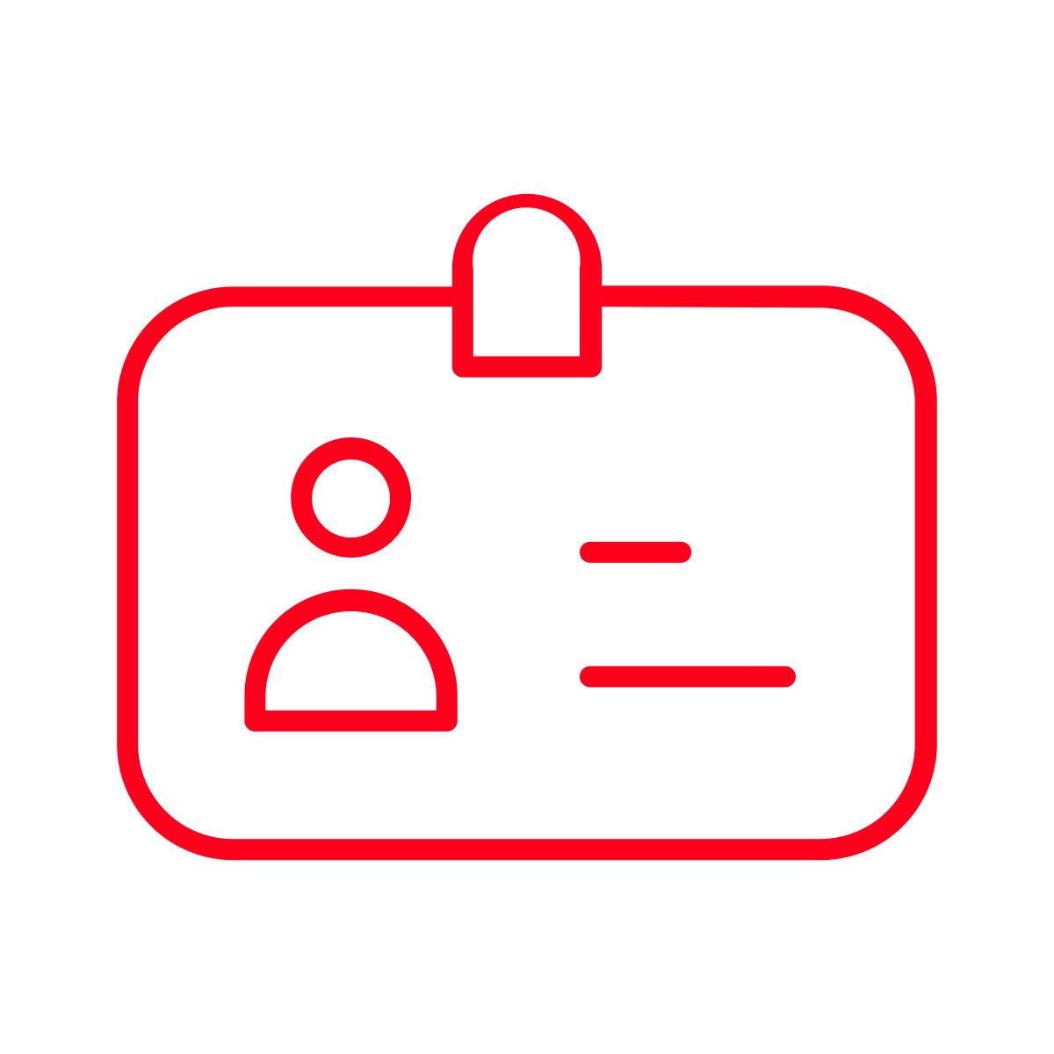
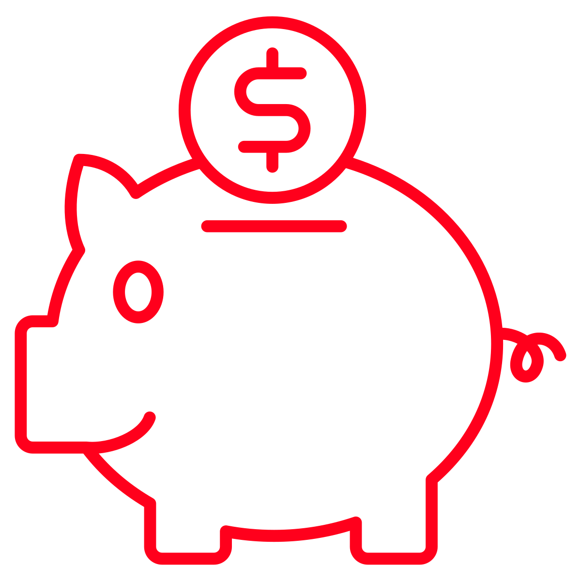
Cx struggled to identify what would motivate them to open the app
Most leaned into savings opportunities:
A few Cx noted that longer DashPass trials would be most motivating for them
40% off
20% off up to $20
Free delivery and 20% off
Rewards program (similar to Starbucks)
3 months was mentioned time frame
Cx did not intend to subscribe beyond the 3 months
These Cx also noted they would have hesitancy to sign up because they might forget

Slide 15
How might we improve reach & impact?

Slide 16
Make the fine print bigger. Things like the maximum discount value and time to use the discount can play a positive role in motivating a Cx to factor a promo into their plans for the week. If the maximum discount is above $5 and there is limited time to redeem, these should be highlighted to communicate value and create a sense of urgency.
Ditch promo codes; offer click to claim/save or click to notify. Cx get many emails and are quick to forget about them after they are used. Creating a flow for Cx where they can click to either 1) claim a coupon to their account, 2) click to save a coupon for future use or 3) click to be notified when a coupon is about to expire will help keep DoorDash top of mind.
Build affordability messages with deeper behavioral analysis. Cx want to feel like their savings communications are personalized to them but they have very specific needs. Ideally our marketing campaigns should align to these needs. Recent address set as home change= help me save and find new restaurants in my neighborhood. Address change indicating potential travel= offer to extend my savings. Always order under 30 mins= help me save and get my food fast.
Lean in to notification/text messages. Overall email fatigue is high, even when emails are opened Cx have no idea it happened. Other channels have higher recall (according to our Cx). Further experimentation is required.
1.
2.
3.
4.

Slide 17
Questions?

